Slide 1

Data Structure Lab 01
Review on C++ concepts and OOP part1

Slide 2
Agenda
C++:
If-else
For, while loop
Continue, break
Function
Structure
Array, Pointers
C++ OOPs:
Class, objects
Constructor
Encapsulation
Function overloading
Destructor

Slide 3
Revision: C++ Concepts

Slide 4
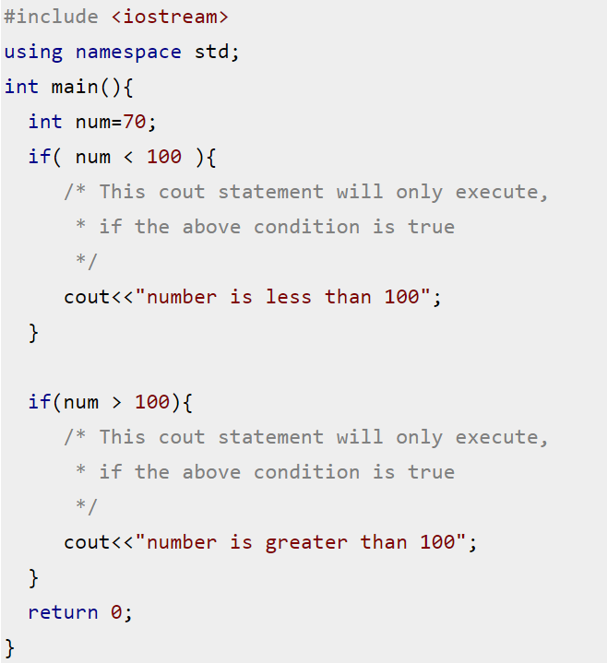
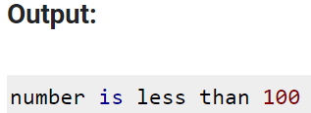
Revision – C++
If else:

Slide 5
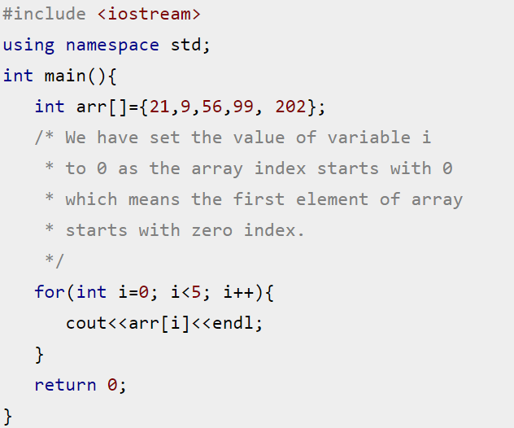
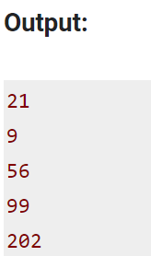
Revision – C++
For loop:

Slide 6
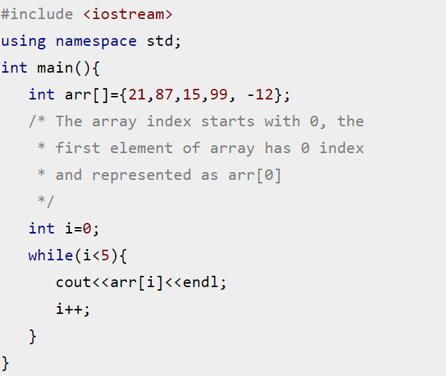
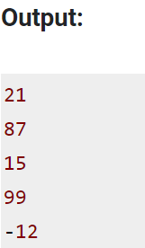
Revision – C++
While loop:

Slide 7
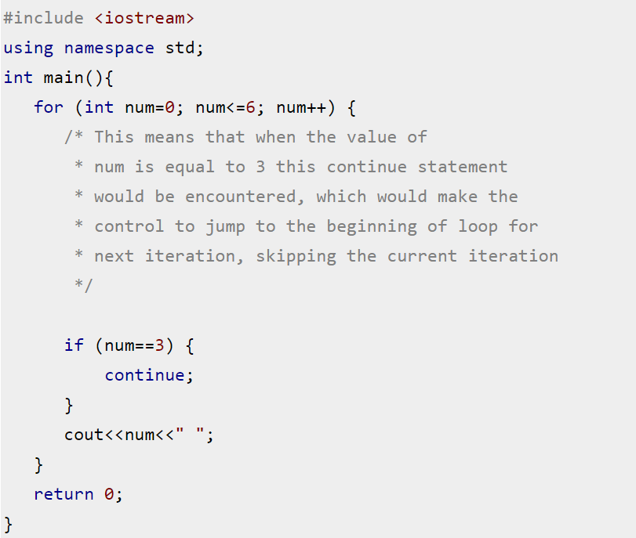
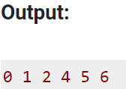
Revision – C++
Continue:

Slide 8
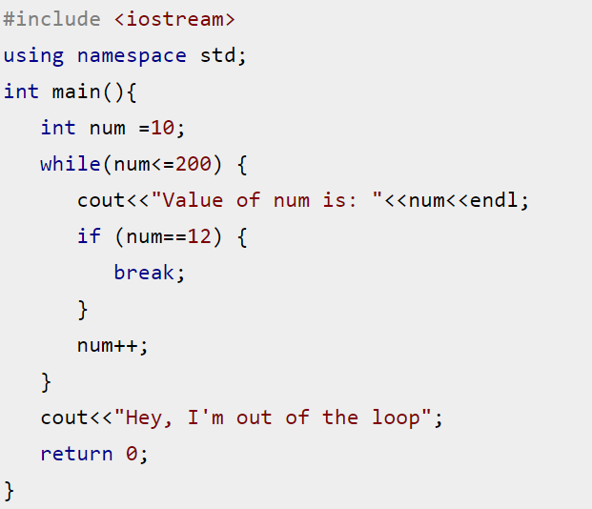
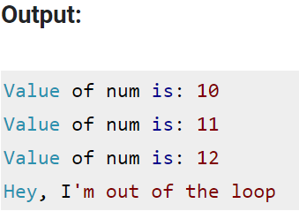
Revision – C++
Break:

Slide 9
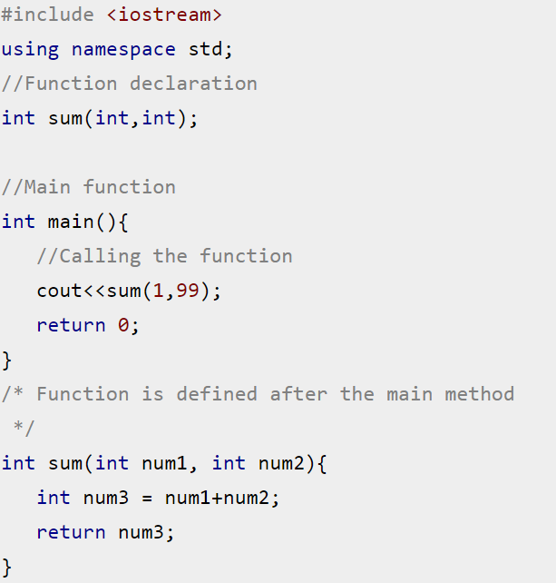
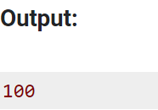
Revision – C++
Function:

Slide 10
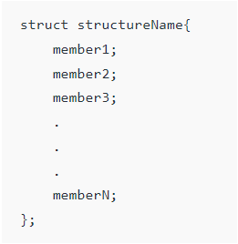
Revision – C++
Structure: A structure is a user-defined data type in C++. A structure creates a data type that can be used to group items of possibly different types into a single type.

Slide 11
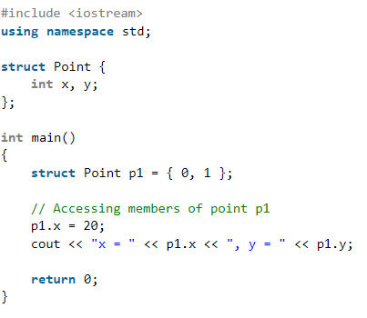
Revision – C++
Structure: A structure is a user-defined data type in C++. A structure creates a data type that can be used to group items of possibly different types into a single type.

Slide 12
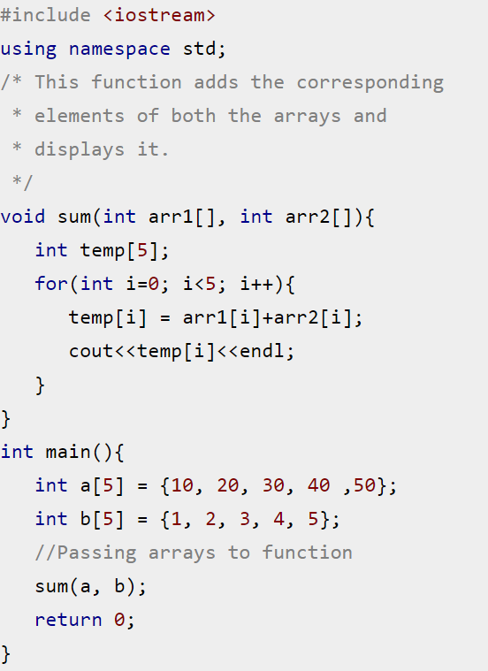
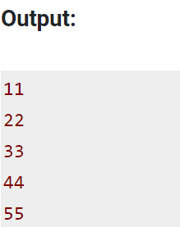
Revision – C++
Passing Array to function:

Slide 13
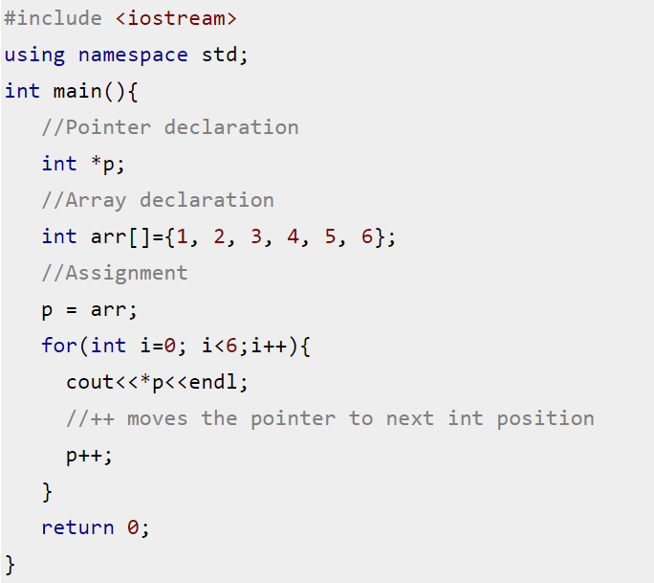
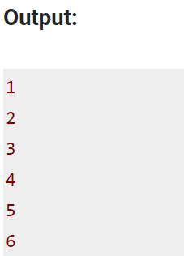
Revision – C++
Pointers:

Slide 14
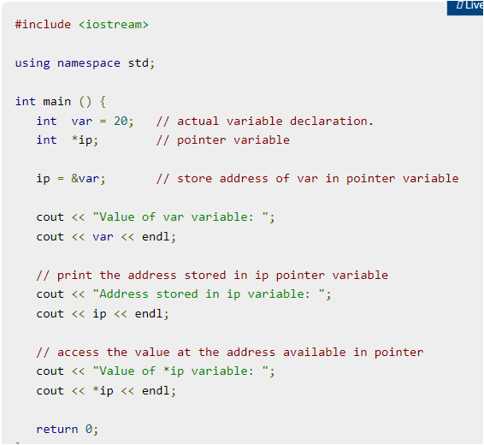

Revision – C++
Pointers:
Output

Slide 15
C++ OOPs

Slide 16
Revision – C++ class and objects
Object oriented programming is a way of solving complex problems by breaking them into smaller problems using objects.
The OOP is all about creating objects that can interact with each other, this makes it easier to develop programs in OOP as we can understand the relationship between them.

Slide 17
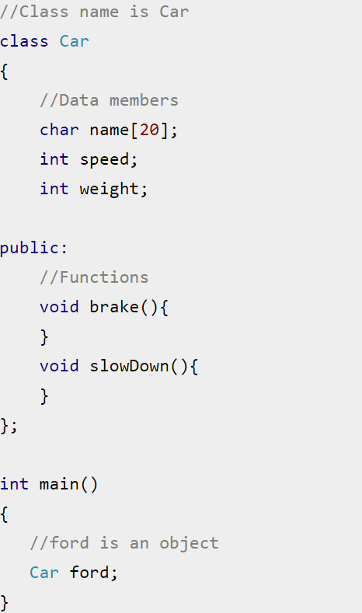
Revision – C++ class and objects
Example:

Slide 18
Summary of OOP
Object-Oriented Programming (OOP) Concepts
Encapsulation
Polymorphism
Inheritance
Information
hiding
Function
overriding
Different ways to inherit classes from other classes
Classes and objects
Constructor
and destructor
Function
overloading
Function
overriding
Access specifier
Getter and setter

Slide 19
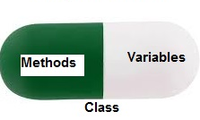
Encapsulation
Encapsulation is defined as binding together the data and the functions that manipulates them.
A class is like a blueprint of data member and functions and object is an instance of class.

Slide 20
Constructor
Constructor is a special member function of a class that initializes the object of the class.
Constructor name is same as class name, and it doesn’t have a return type.

Slide 21
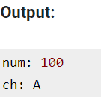
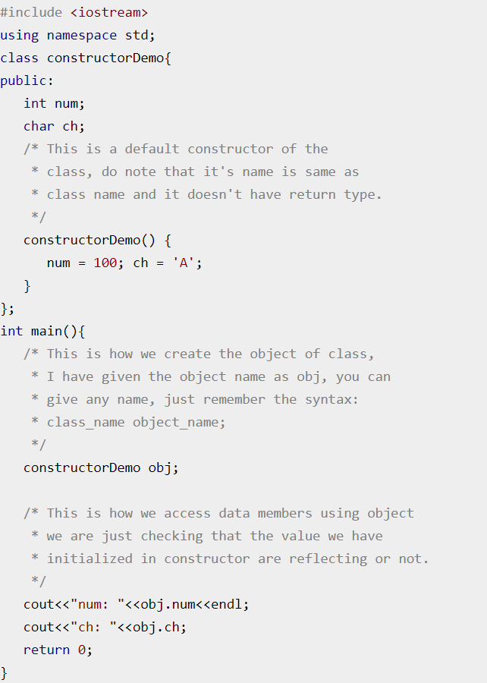
Example:

Slide 22
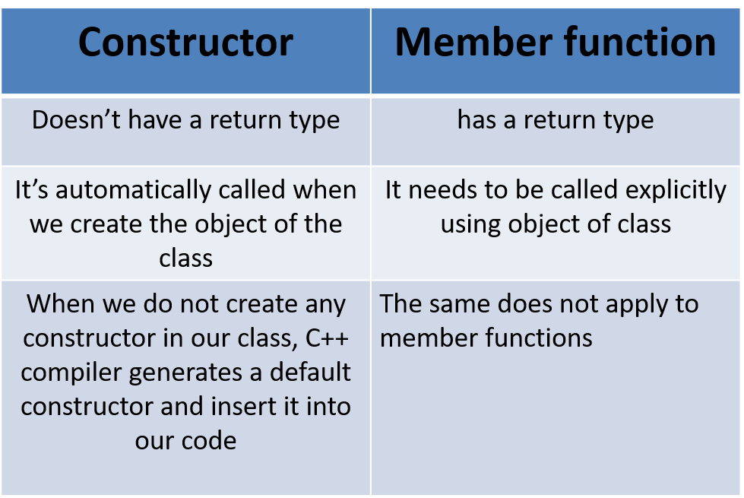
Difference between Constructor and Member function

Slide 23
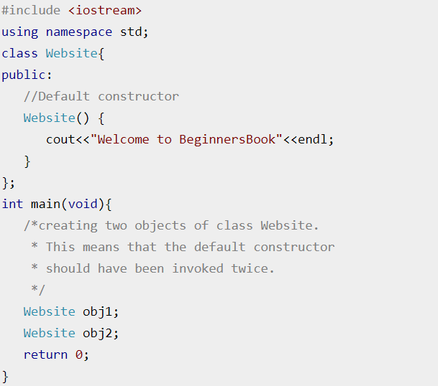
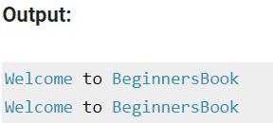
Types of Constructor in C++
1. Default Constructor:
Doesn’t have any arguments (or parameters).

Slide 24
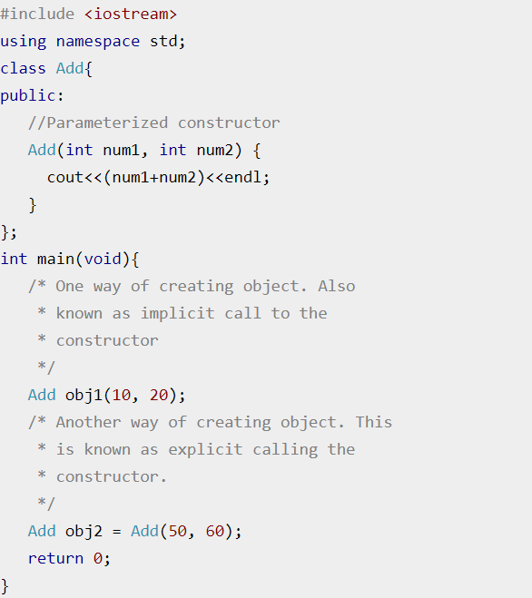
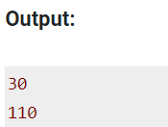
Types of Constructor in C++
2. Parameterized Constructor:
These type of constructor allows us to pass arguments while object creation.

Slide 25
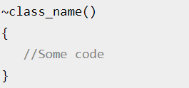
Destructor
A destructor is a special member function that works just opposite to constructor, unlike constructors that are used for initializing an object, destructors destroy (or delete) the object.
Syntax of Destructor:

Slide 26
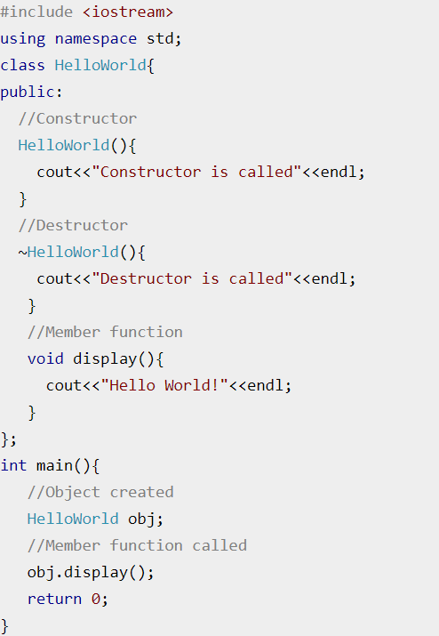
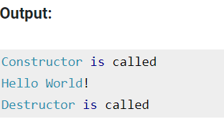
Example:

Slide 27
Destructor Rules:
Name should begin with tilde sign(~) and must match class name.
There cannot be more than one destructor in a class.
Unlike constructors that can have parameters, destructors do not allow any parameter.
They do not have any return type, just like constructors.
When you do not specify any destructor in a class, compiler generates a default destructor and inserts it into your code.

Slide 28
Summary of OOP
Object-Oriented Programming (OOP) Concepts
Encapsulation
Polymorphism
Inheritance
Information
hiding
Function
overriding
Different ways to inherit classes from other classes
Classes and objects
Constructor
and destructor
Function
overloading
Function
overriding
Access specifier
Getter and setter

Slide 29
Polymorphism
Polymorphism is a powerful concept in OOP and allows for more flexible and extensible code by promoting code reuse and reducing the amount of duplicate code required.

Slide 30
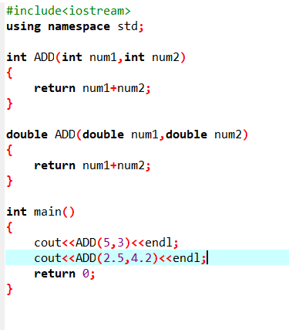
Function Overloading
Functions with same name and different parameters
Overloaded functions should perform similar tasks

Slide 31
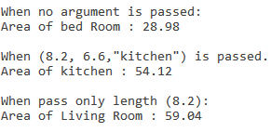
Example
Write a program to handle Rooms of any apartment by creating Room Class.
Member variables: Length, breadth, room_name.
Make three constructors:
Default: length = 6.9, breadth = 4.2, room_name = “bed Room”.
Parameterized: by passing (Length, breadth, room_name) to member variables.
Constructor with passing one argument (Length) and fixed breadth = 7.2 and room_name = “Living Room”.
Apply Encapsulation by using Setters and getters.
Calculate Area of the Room.
Create 3 objects to apply every constructor type.
Print to get this output ----->

Slide 32
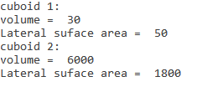
Task 1:
Write a Program to Find the Volume and Lateral Surface Area of a Cuboid.
Member variables:
Length “l” (int)
Width “w” (int)
Height “h” (int)
You must use encapsulation.
Volume of a Cuboid = L * W * H
Lateral Surface Area of a Cuboid = 2* H * (L + W)
Apply constructor overloading:
Default (L = 2, W= 3, H= 5)
Parameterized with L = 10 ,W = 20 , H = 30
Member Methods:
Setters and getters
calcVolume
calcSurfArea
Required Output

Slide 33
Thank You!

